Slide 1
Some dirty, quick and well-known tricks to hack your bad .NET WebApps
Some dirty, quick and well-known tricks to hack your bad .NET WebApps
Chema Alonso
(@chemaalonso)

Slide 2
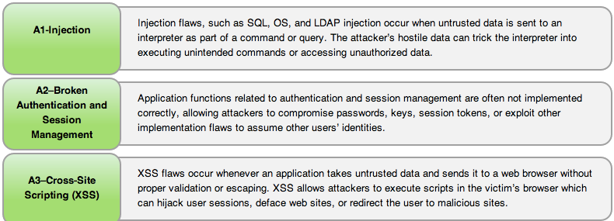
OWASP Top Ten

Slide 3
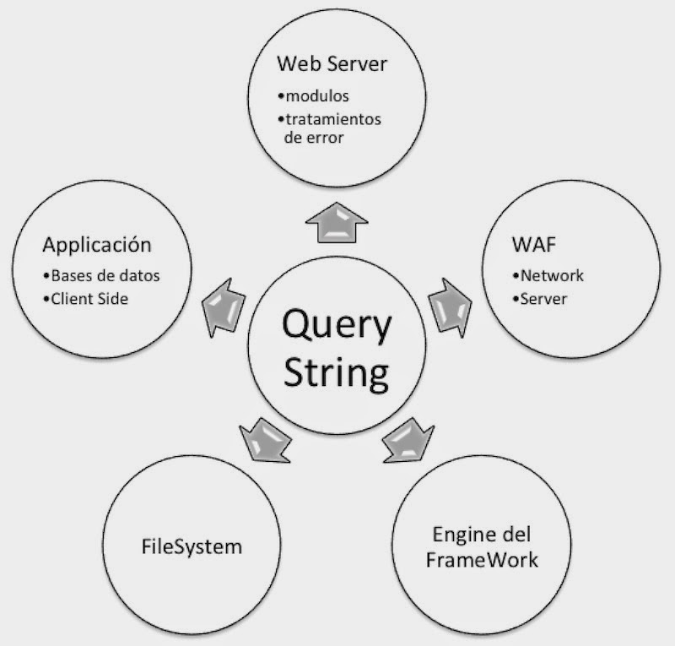
Error Messages

Slide 4
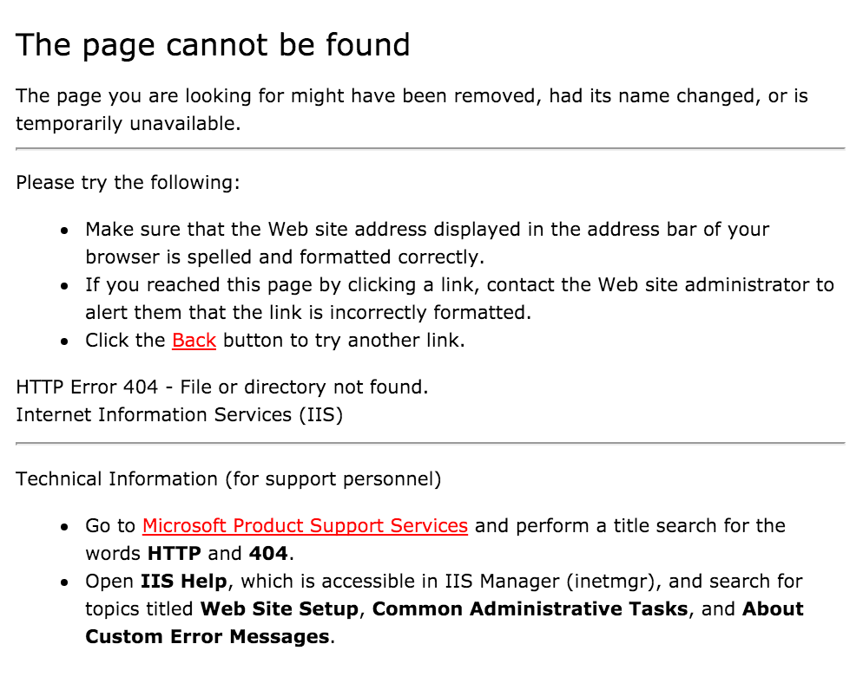
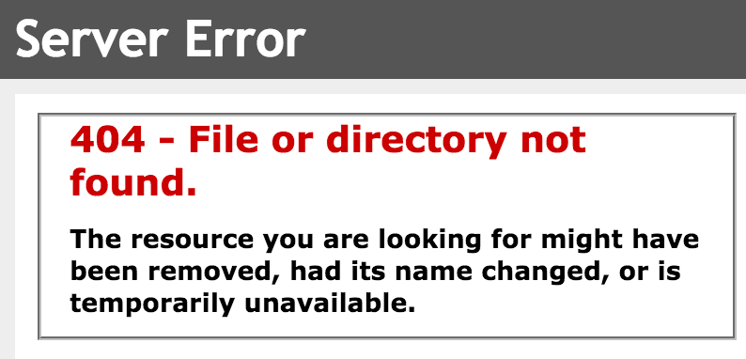
IIS Error Messages - 404

Slide 5
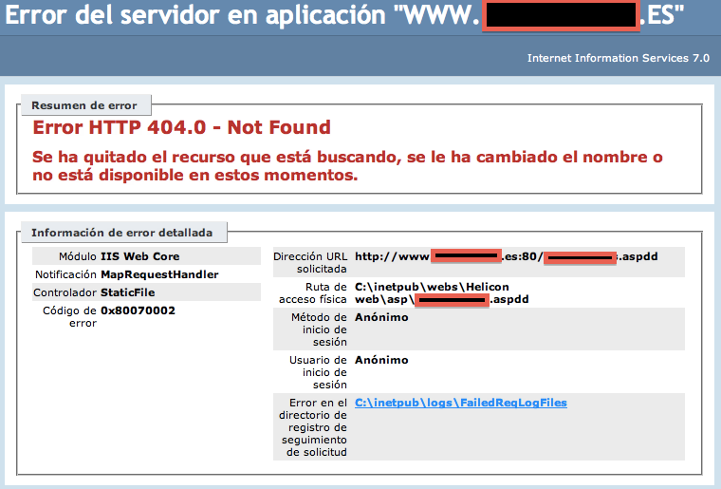
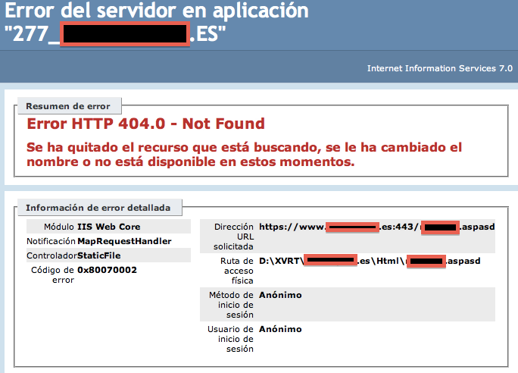
ASP Error Messages

Slide 6
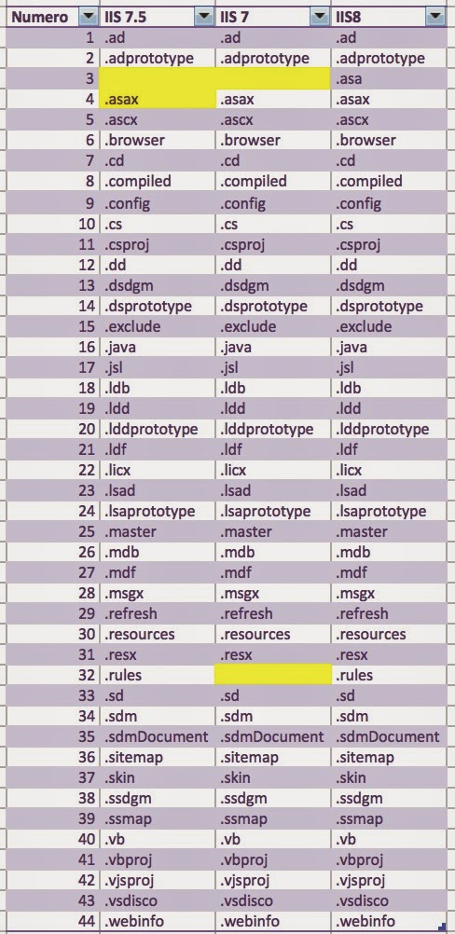
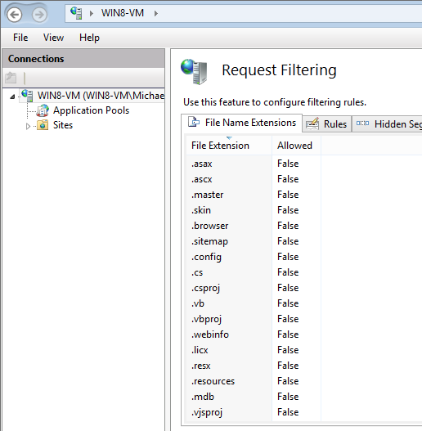
Request Filtering

Slide 7
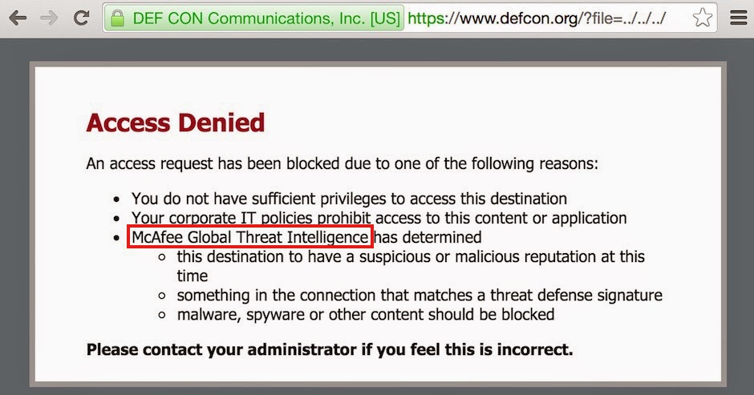
WAF filter

Slide 8
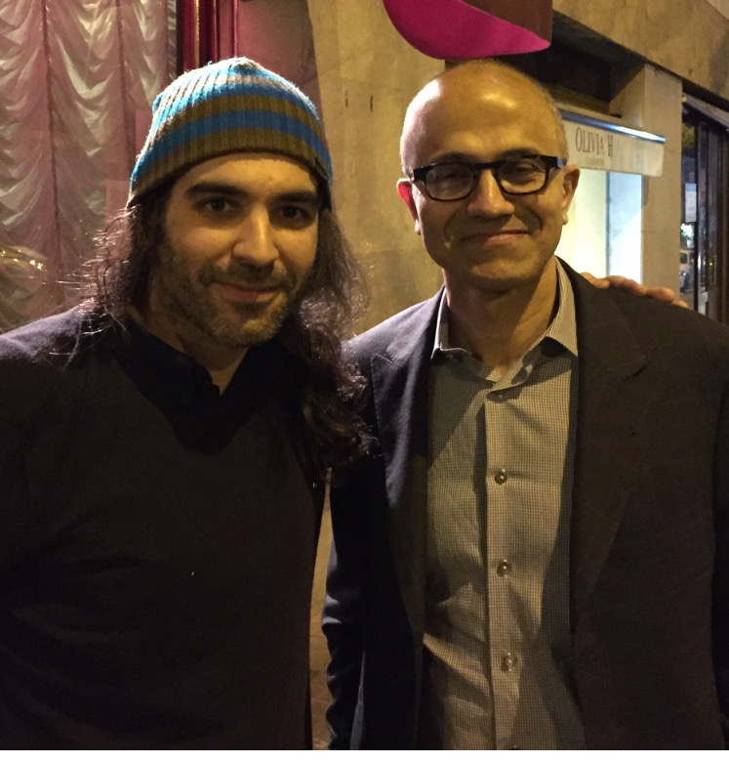
Demo 1:
Hay un error en mí

Slide 9
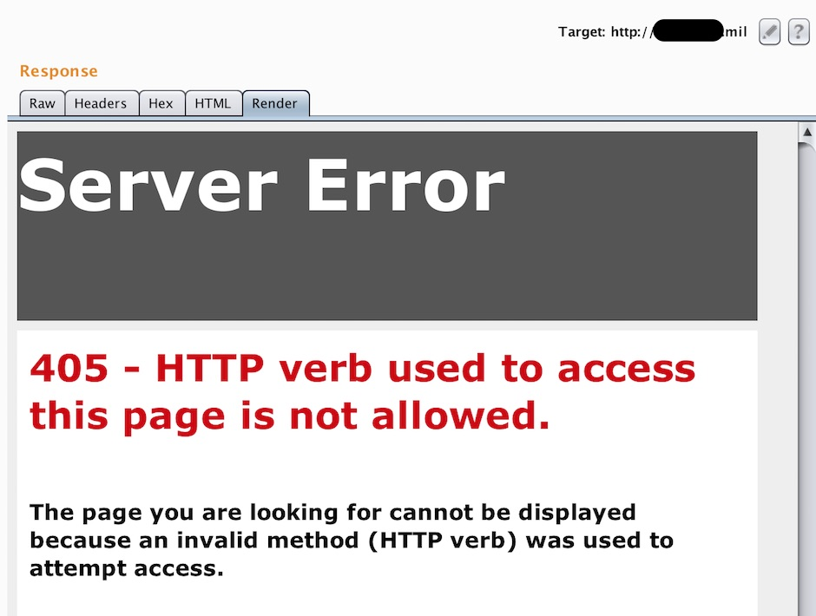
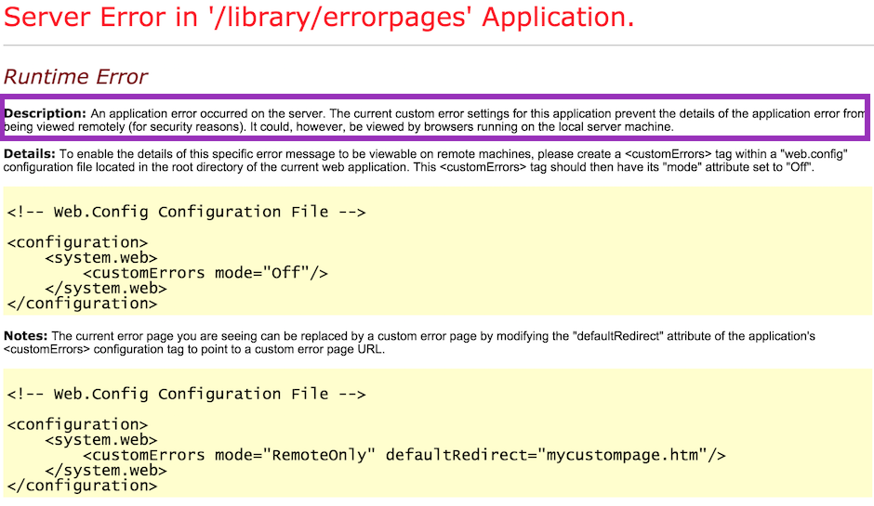
Server Error – 405,500,…

Slide 10
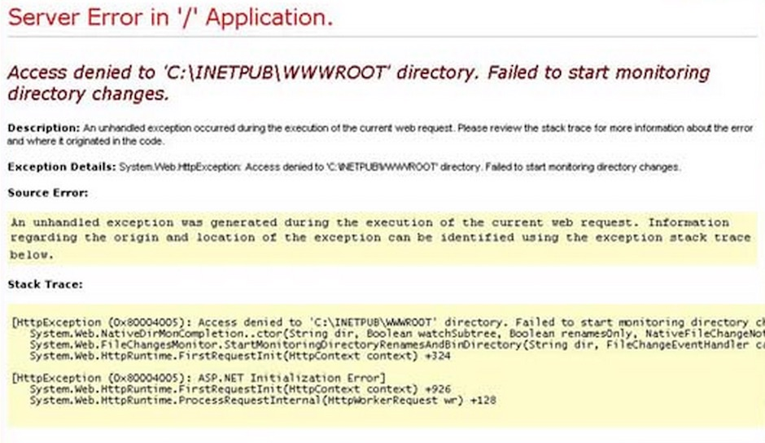
.NET CustomErrors
<system.web>
<customErrors mode="On|Off|RemoteOnly" defaultRedirect="~/Error/Index" />
</ system.web>

Slide 11
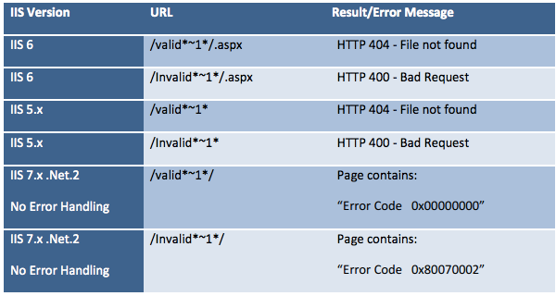
IIS Short Name Bug

Slide 12
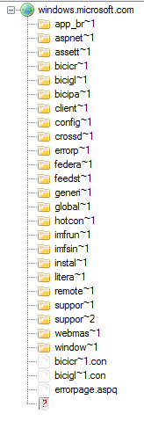
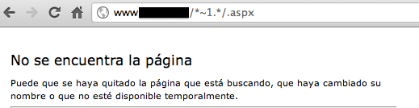
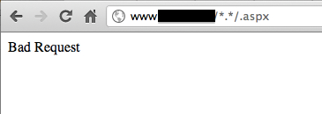
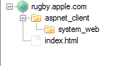
IIS Short Name Bug

Slide 13
Demo 2
Hay un IIS en mí

Slide 14
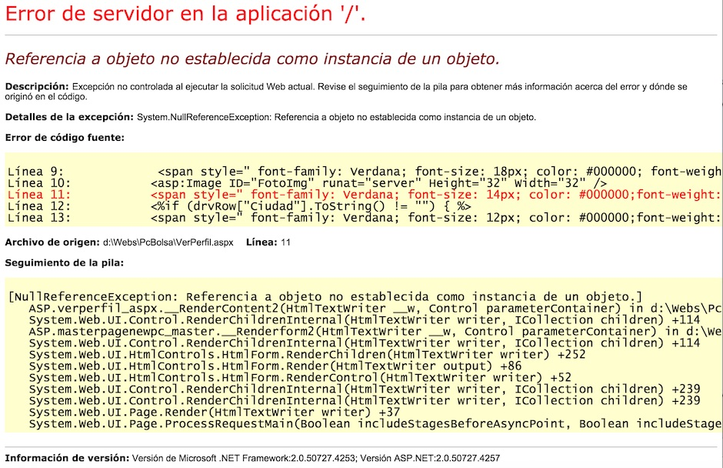
Debug Mode
<configuration>
<system.Web>
<compilation debug="true">
<system.Web>
</configuration>

Slide 15
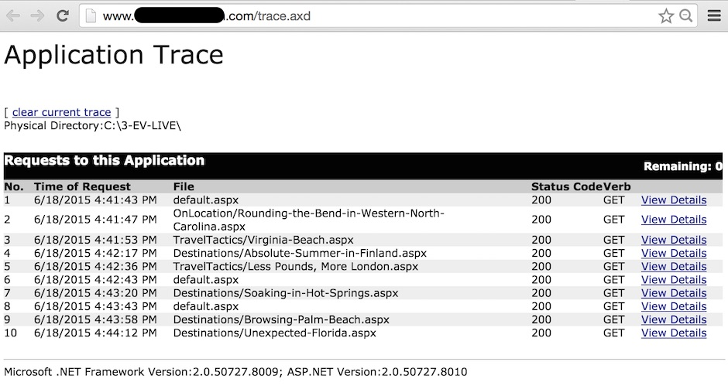
Trace.axd

Slide 16
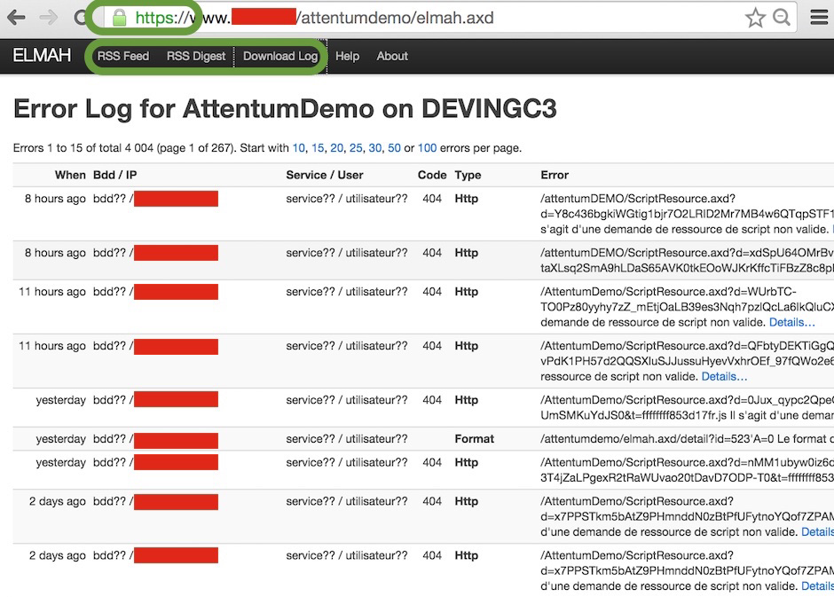
Elmah

Slide 17
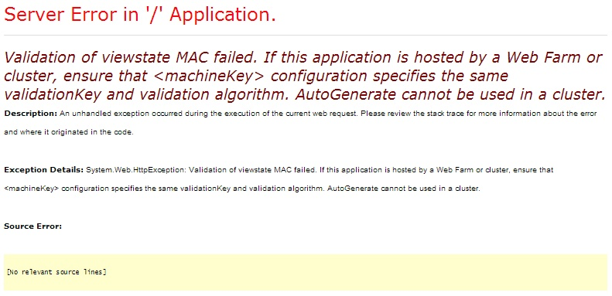
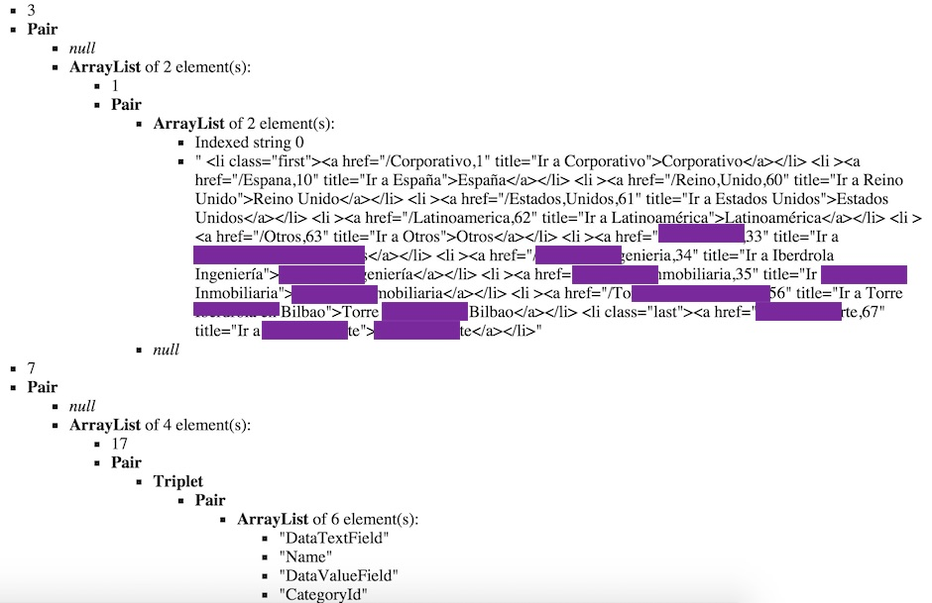
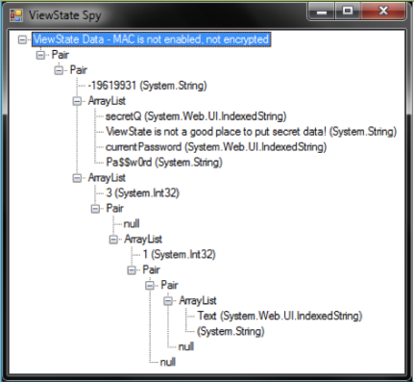
ViewState Disclosure

Slide 18
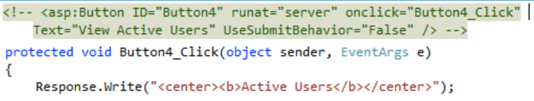
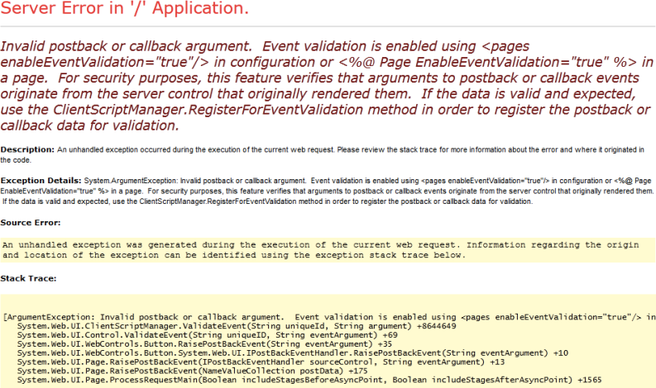
Hidden Controls

Slide 19
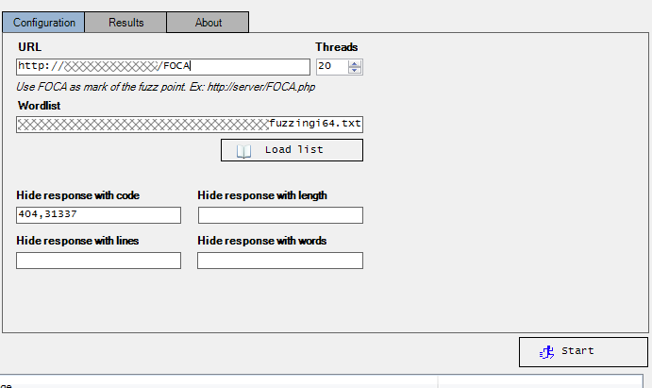
Fuzzins, Fuzzinj, Fuzzing

Slide 20
Demo 3:
1,2,3. Probando, probando.

Slide 21
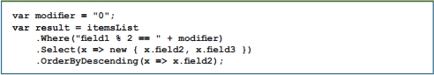
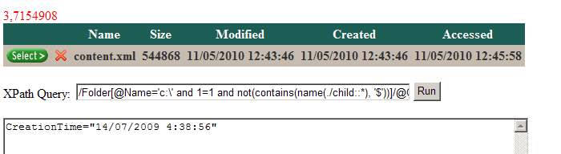
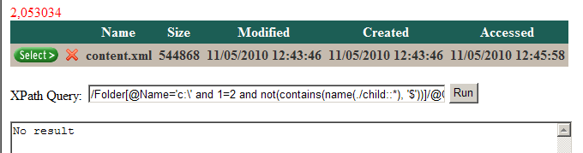
LinQ Injection: SQL, Xpath, …

Slide 22
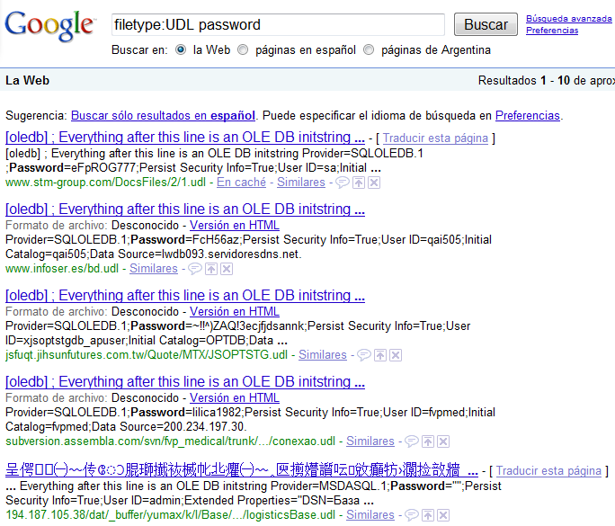
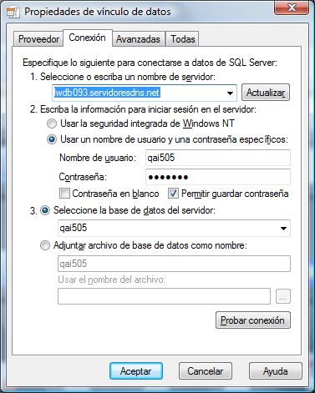
UDL (Universal Data Links) Files

Slide 23
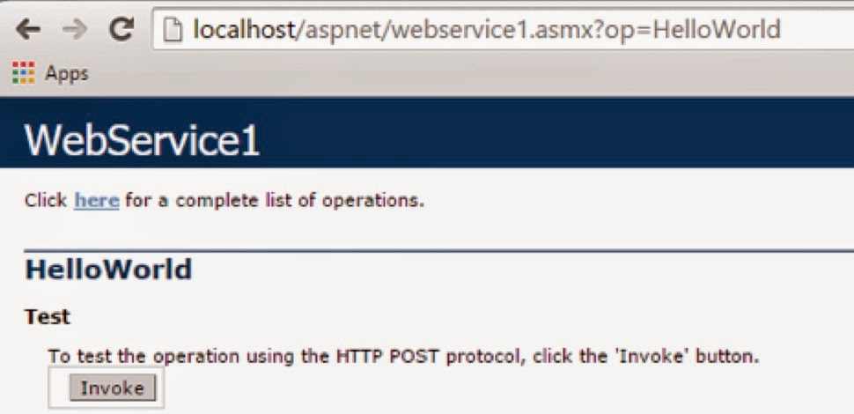
WebServices

Slide 24
Demo 4
Buscando por debajo de tu Backend

Slide 25
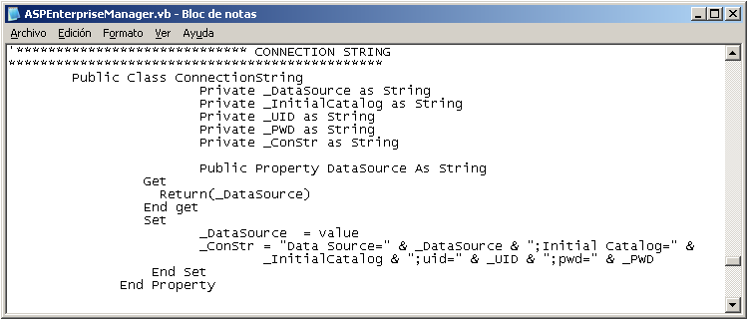
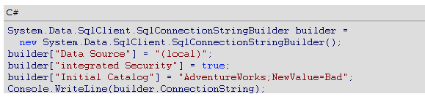
Connection String Parameter Pollution

Slide 26
Pollutionable Behavior
Param1=Value A
Param2=Value B
Param1=Value C
Param2=Value D
DBConnection Object
Param1
Param2

Slide 27
What can be done with CSPP?
Data Source=DB1
UID=sa
password=Pwnd!
Data Source=DB2
DBConnection Object
DataSource
UID
password

Slide 28
CSPP Attack: Hijacking Web Credentials
Data source = SQL2005; initial catalog = db1;
Integrated Security=no; user id=+’User_Value’+;
Password=+’Password_Value’+;
Data source = SQL2005; initial catalog = db1;
Integrated Security=no; user id= ;Data Source=Target_Server;
Password=;Integrated Security=true;

Slide 29
Demo 5
Po-lu-cionate. Mézclate conmigo.

Slide 30
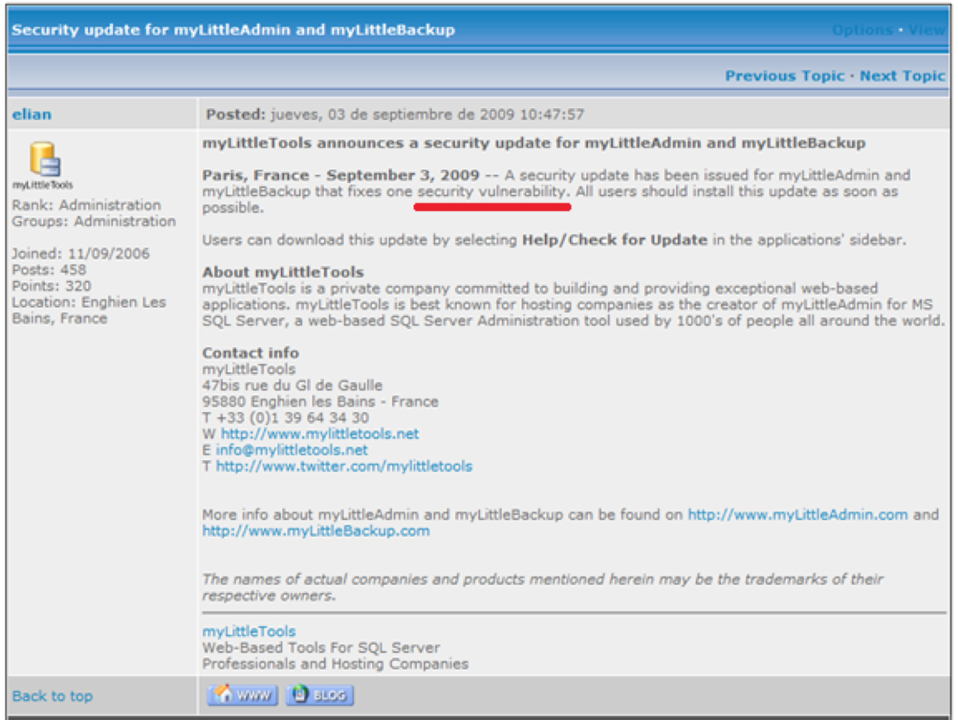
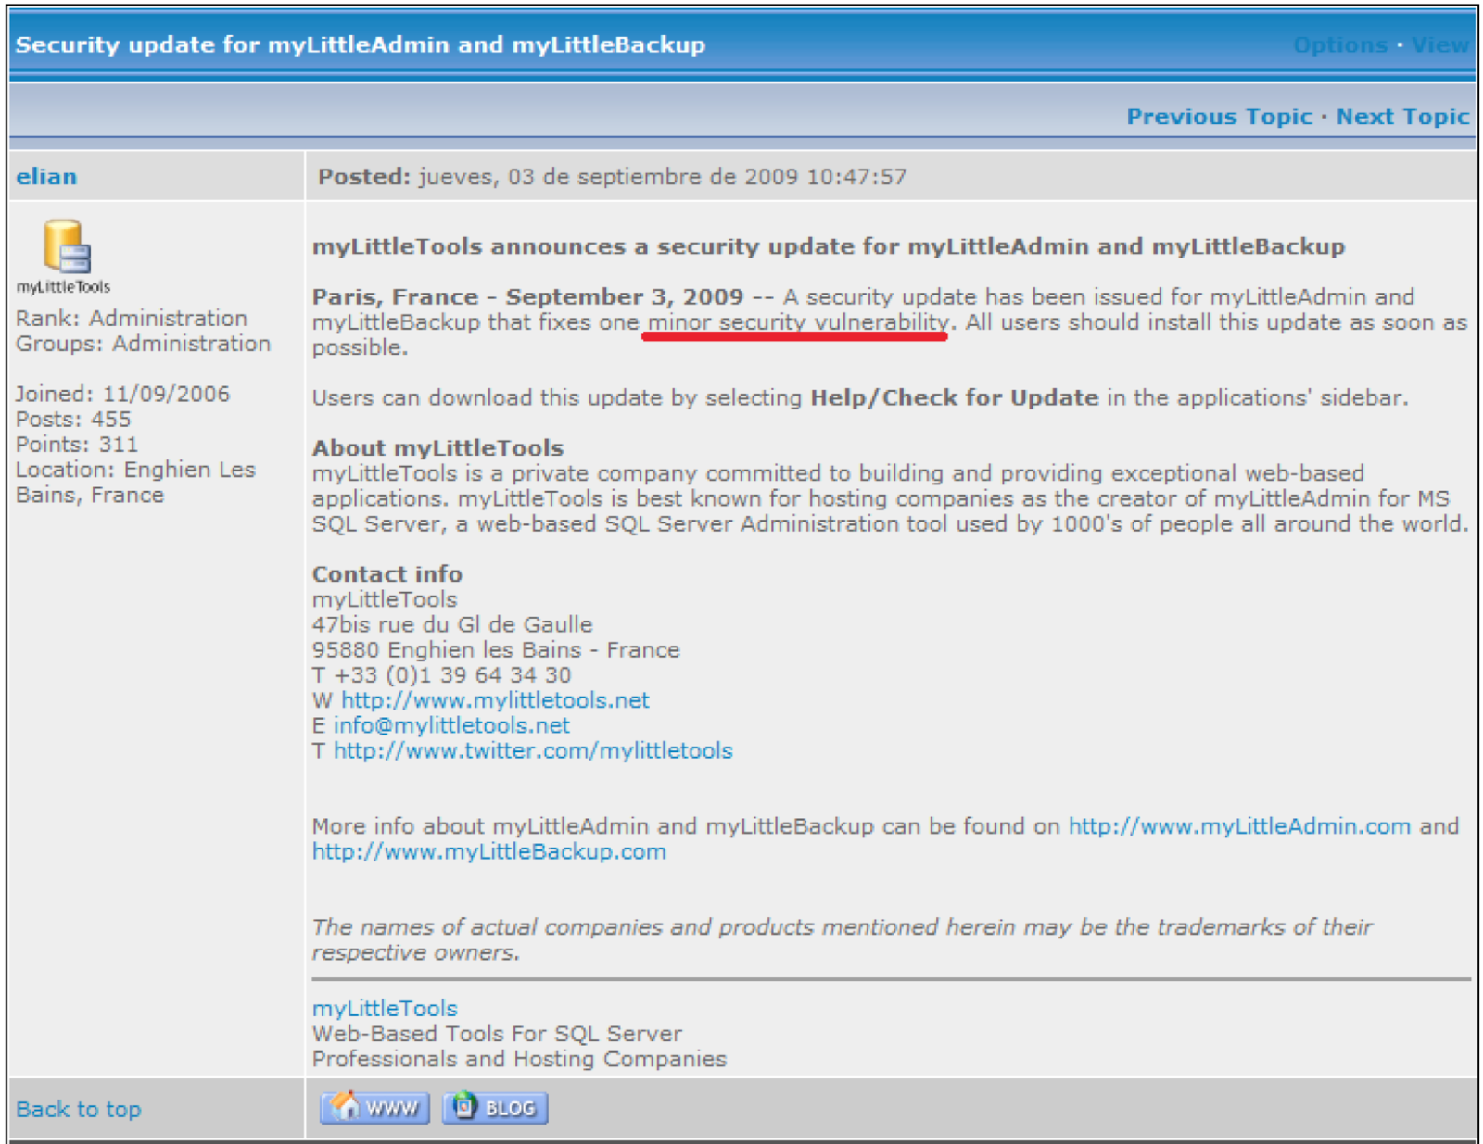
CSPP Bugs

Slide 31
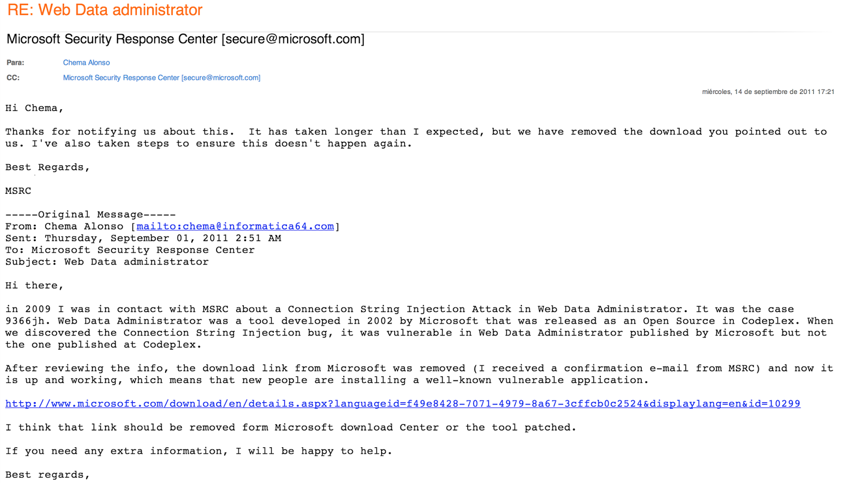
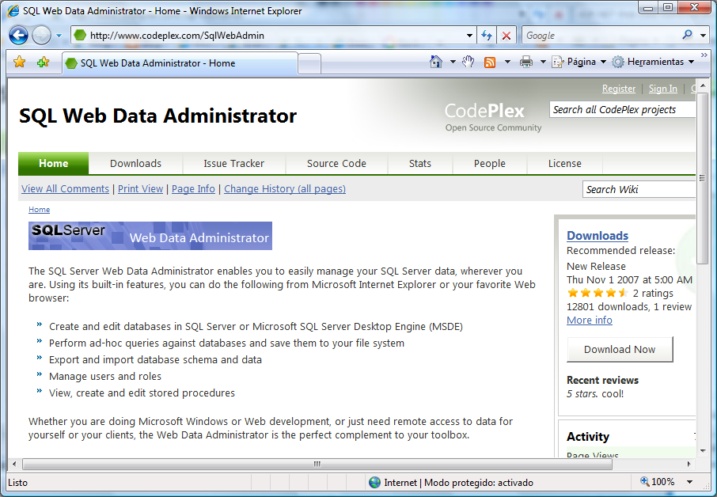
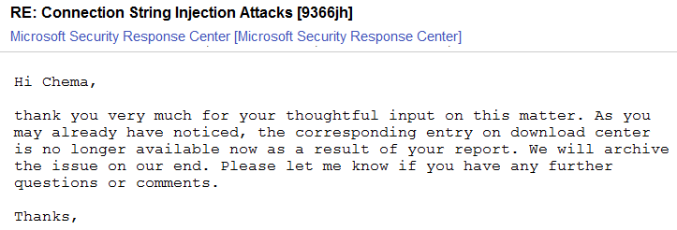
ASP.NET Web Data Admistrator
ASP Web Data Administrator is secure in CodePlex web site, but not in Microsoft web site where an unsecure old version is was published

Slide 32
Poor Hardening
Bad HTTPs implementations
Bad Digital Certificate Management
Weak Cyphers
Well-Known Bugs (HeartBleed)
Mixed HTTP/HTTPs
SSLStrip
Secure/HTTPOnly Flags
HSTS
Use your imagination

Slide 33


Questions?

